Slide 1
Waveguide Tee
H-plane Tee
E-plane Tee
Magic Tee
Hybrid Rings
Corners
Bends
Twists

Slide 2
Tee Junction
A waveguide or coaxial-line junction with three independent ports
Matrix of third order, containing nine elements, six of which should be independent.
The characteristics of a three port junction can be explained by three theorems of the tee junction.
These theorems are derived from the equivalent-circuit representation of the tee junction

Slide 3
Statements
A short circuit may always be placed in one of the arms of a three-port junction in such a way that no power can be transferred through the other two arms.
If the junction is symmetric about one of its arms, a short circuit can always be placed in that arm so that no reflections occur in power transmission between the other two arms. (i.e the arms present matched impedances.)

Slide 4
3. It is impossible for a general three-port junction of arbitrary symmetry to present matched impedances at all three arms.

Slide 5
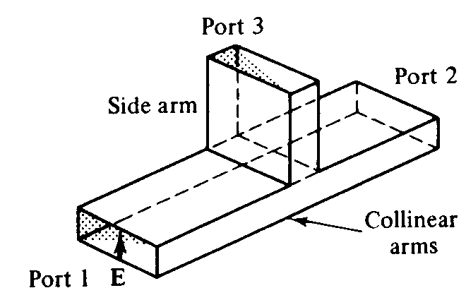
E-plane Tee
Series Tee
A waveguide tee in which the axis of its side arm is parallel to the E-field of the main guide.

Slide 6
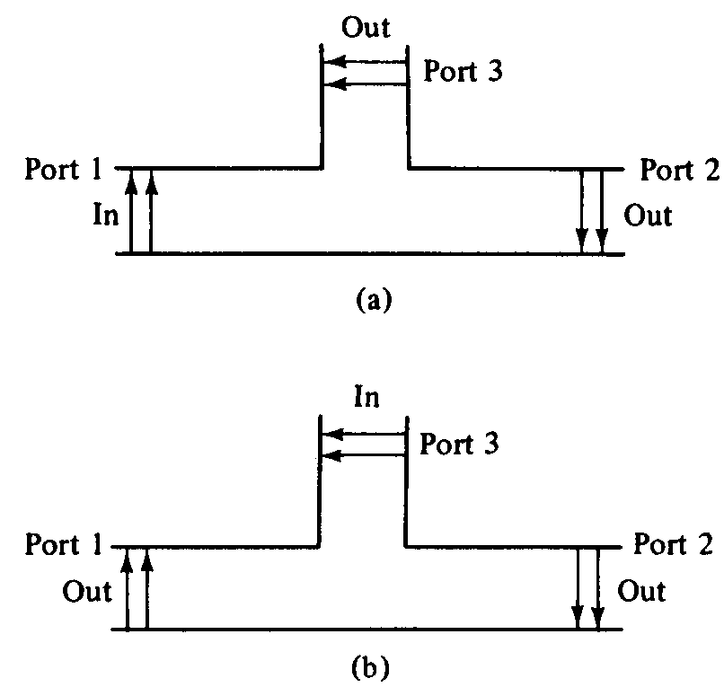
If the collinear arms are symmetric about the side arm, there are two different transmission characteristics
Two way
Transmission of
E-plane tee
i/p-main arm
i/p-side arm

Slide 7
If E-plane tee is perfectly matched with the aid of screw tuners or inductive or capacitive windows at the junction, the diagonal components of the S-matrix, S11, S22 and S33 are zero because there will be no reflection.
When the waves are fed into the side arm (port 3), the waves appearing at port1 and port2 of the collinear arm will be in the opposite phase and in the same magnitude. Therefore,
S13 = -S23 (both have opposite signs)

Slide 8
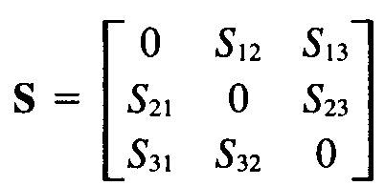
For a matched junction, the S matrix is given by
Symmetry property
S12 = S21, S13 = S31 and S23 = S32
Zero property,
The sum of (each term of any column (row) multiplied by the complex conjugate of the corresponding terms of any column(row) is zero. )

Slide 9
S11S12* + S21S22* + S31S32* = 0
Hence,
S13S23* = 0
i.e S13 = 0 or S23 = 0 or both = 0

Slide 10
Unity property,
The sum of the products of each term of any one row (column) multiplied by its complex conjugate is unity
S21S21* + S31S31* = 1 I
S12S12* + S32S32* = 1 II
S13S13* + S23S23* = 1 III
Subst zero property in unitary property

Slide 11

IV
Eq III and IV are contradictory
If S13 = 0 then S23 = 0 and thus eqn III is false.
Similarly, if S23 = 0, then S13 = 0 and hence eq IV is also not true.
This inconsistency proves the statement that the tee junction cannot be matched to the three arms.
Diagonal elements are not all zero

Slide 12


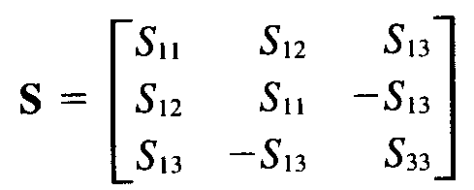
When an E-plane is constructed of an empty waveguide, it is poorly matched at the tee junction.
Hence
However since the collinear arm is usually symmetric about the side arm,
Thus,

Slide 13
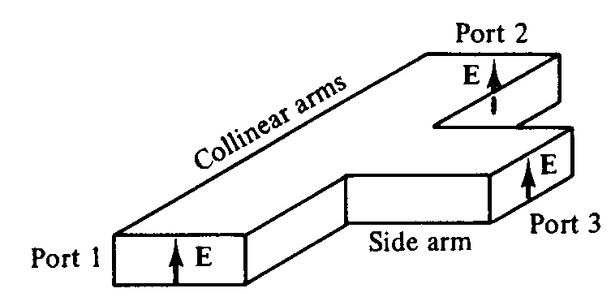
H-Plane Tee
Shunt tee
A waveguide tee in which the axis of its side arm is “shunting” the E-field or parallel to the H-field of the main guide.

Slide 14
If two input waves are fed into port 1 and port 2 of the collinear arm, the output wave at port 3 will be in phase and additive.
If the input is fed into port 3, the wave will split equally into port 1 and port 2 in phase and in the same magnitude.
Therefore the S matrix of H-plane tee is similar to E-plane tee except
S13 = S23

Slide 15
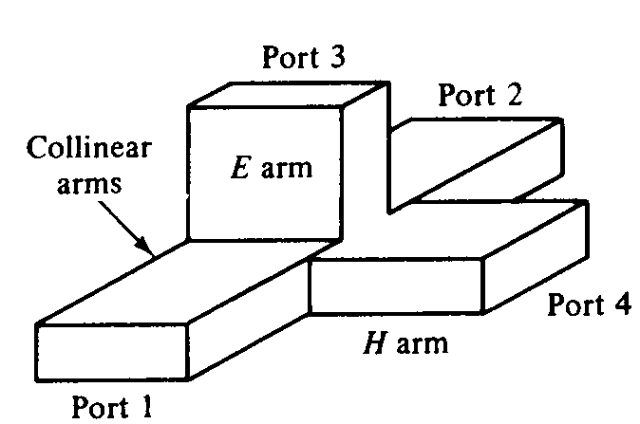
Magic Tees (Hybrid Tees)
Combination of E-plane tee and H-plane tee.

Slide 16
Characteristics
If two waves of equal magnitude and the same phase are fed into port 1 and port 2, the output will be zero at port 3 and additive at port 4
If a wave is fed into port 4 (H arm), it will be divided equally between port 1 and port 2 of the collinear arms and will not appear at port 3 (E arm).
If a wave is fed into port 3 (E arm), it will produce an output of equal magnitude and opposite phase at port 1 and port 2. Output at port 4 is zero i.e S43 = S34 = 0.

Slide 17
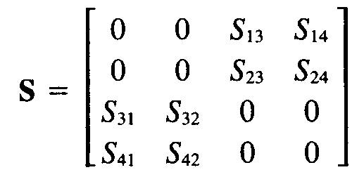
4. If a wave is fed into one of the collinear arms at port 1 or port 2, it will not appear in the other collinear arm at port 2 or port 1 because the E arm causes a phase delay while the H arm causes the phase advance. i.e S12 = S21 = 0.
S matrix of magic tee is

Slide 18
Application
Mixing
Duplexing
Impedance measurements.
Radar transmitters

Slide 19
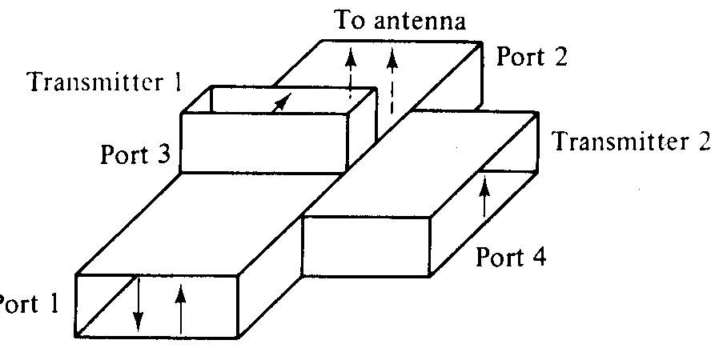
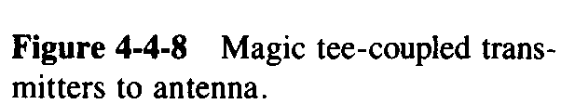

Slide 20
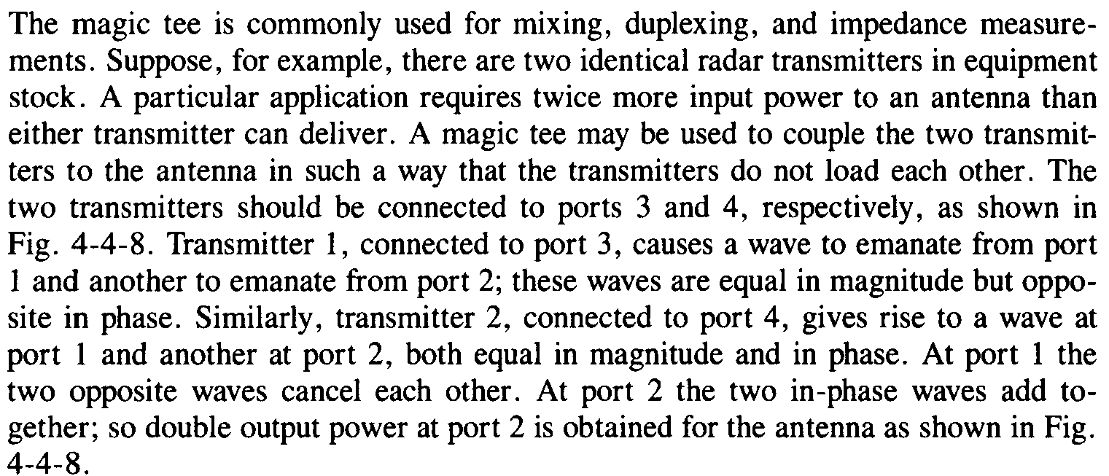

Slide 21
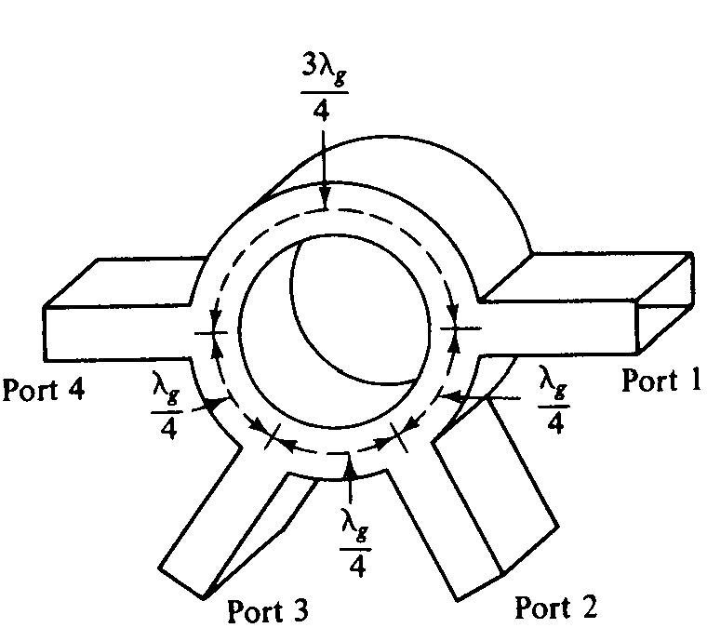
Hybrid Rings (Rat-Race Circuits)
Annular line of proper electrical length to sustain standing waves, to which four arms are connected at proper intervals by means of series or parallel junctions.
Hybrid ring
With series
junctions

Slide 22
Characteristics similar to hybrid tee.
When a wave is fed into port 1, it will not appear at port 3 because the difference of phase shifts for the waves travelling in the clockwise and anticlockwise directions is 180.
Thus the waves are cancelled at port 3.
Similarly the waves fed into port 2 will not emerge at port 4 and so on.

Slide 23
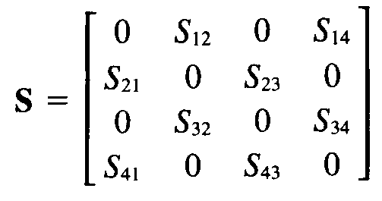
S matrix for an ideal hybrid ring
Phase cancellation occurs only at designated frequency for an ideal hybrid ring.
In actual hybrid rings there are small leakage couplings, and hence the zero elements in the matrix above are not quite equal to zero.

Slide 24
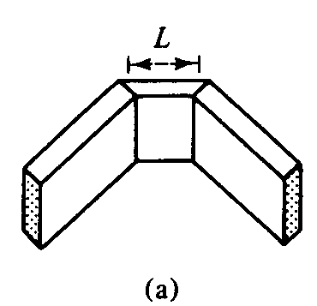
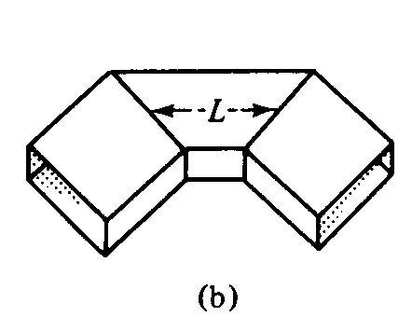
Waveguide Corners, Bends, and Twists
E plane Corner
H-plane corner

Slide 25
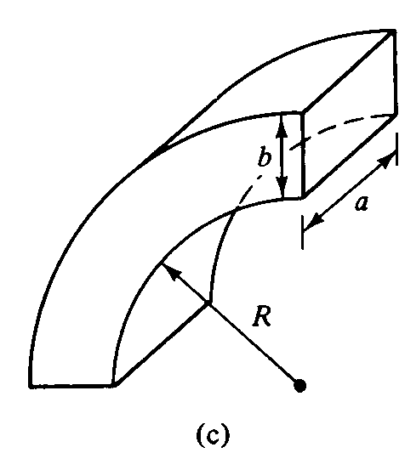
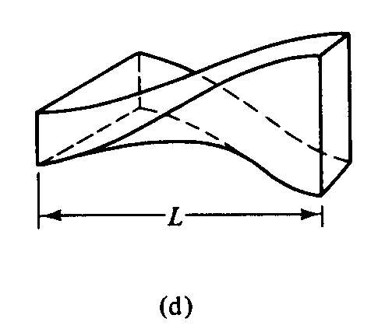
Bend
Continuous twist

Slide 26

These waveguide components are normally used to change the direction of the guide through an arbitrary angle.
In order to minimize reflections from the discontinuities, it is desirable to have the mean length L between continuities equal to an odd number of quarter wavelengths.
i.e

Slide 27


If the mean length L is an odd number of quarter wavelengths, the reflected waves from both ends of the waveguide section are completely cancelled.
For the waveguide bend, the minimum radius of curvature for a small reflection is given by Southworth as
Where a and b are the dimensions of the bend.

Slide 28
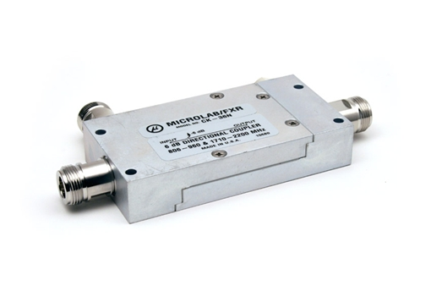
DIRECTIONAL COUPLER
Parameters & Its Applications
This webpage gives information about the Microwave Engineering Course.
This webpage gives information about the Microwave Engineering Course.

Slide 29
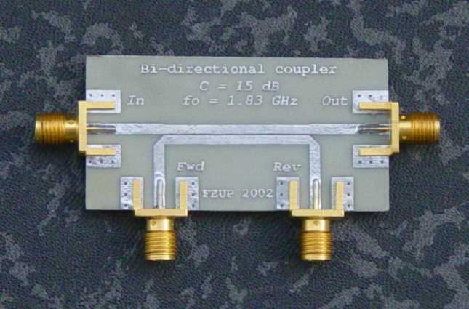
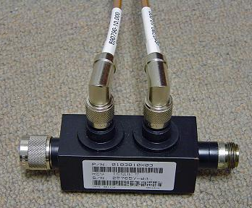
DIRECTIONAL COUPLER
A directional coupler is a passive device which couples part of the transmission power by a known amount out through another port, often by using two transmission lines set close enough together such that energy passing through one is coupled to the other.
The device has four ports: input, transmitted, coupled, and isolated. The term "main line" refers to the section between ports 1 and 2.
Common properties desired for all directional couplers are wide operational bandwidth, high directivity, and a good impedance match at all ports when the other ports are terminated in matched loads.

Slide 30
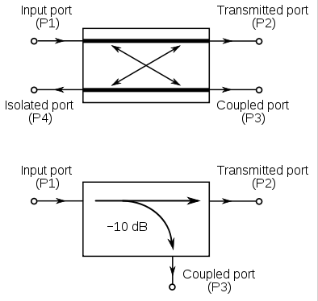

Slide 31
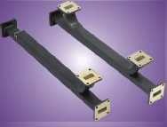

PARAMETERS:
Coupling factor:
The coupling factor is defined as:
where P₁ is the input power at port 1 and P₃ is the output power from the coupled port.
The coupling factor represents the primary property of a directional coupler.
Coupling is not constant, but varies with frequency.

Slide 32
continued……
Directional couplers are specified in terms of the coupling accuracy at the frequency band center. For example, a 10 dB coupling ± 0.5 dB means that the directional coupler can have 9.5 dB to 10.5 dB coupling at the frequency band center.
The accuracy is due to dimensional tolerances that can be held for the spacing of the two coupled lines.
Another coupling specification is frequency sensitivity. A larger frequency sensitivity will allow a larger frequency band of operation.

Slide 33


Loss
The main line insertion loss from port 1 to port 2 (P₁ – P₂) is:
Insertion loss:
Part of this loss is due to some power going to the coupled port and is called coupling loss and is given by-
Coupling loss:

Slide 34
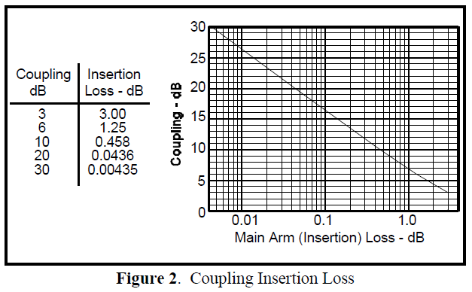
continued……
The actual directional coupler loss will be a combination of coupling loss, dielectric loss, conductor loss, and VSWR loss. Depending on the frequency range, coupling loss becomes less significant above 15 dB coupling where the other losses constitute the majority of the total loss.
A graph of the theoretical insertion loss (dB) vs coupling (dB) for adissipationless coupler is shown in Figure 2.

Slide 35
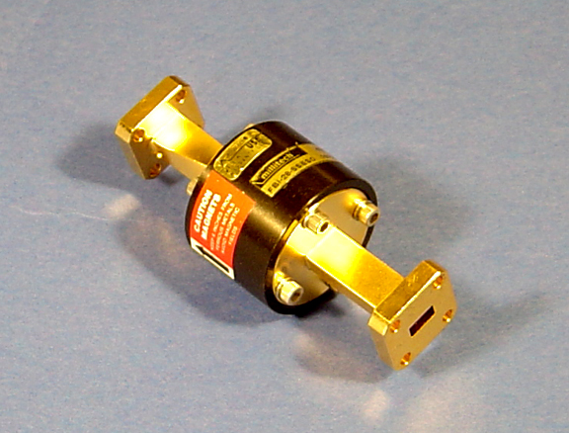

Isolation
Isolation of a directional coupler can be defined as the difference in signal levels in dB between the input port and the isolated port when the two other ports are terminated by matched loads.
Isolation:
It can also be defined between the two output ports. In this case, one of the output ports is used as the input; the other is considered the output port while the other two ports (input and isolated) are terminated by matched loads.

Slide 36

continued……
Consequently:
The isolation between the input and the isolated ports may be different from the isolation between the two output ports.
For example, the isolation between ports 1 and 4 can be 30 dB while the isolation between ports 2 and 3 can be a different value such as 25 dB. Isolation can be estimated from the coupling plus return loss.

Slide 37
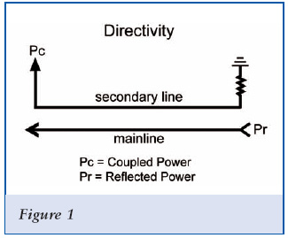

Directivity
Directivity is directly related to isolation. It is defined as:
where: P₃ is the output power from the coupled port and P₄ is the power output from the isolated port.
The directivity should be as high as possible. The directivity is very high at the design frequency and is a more sensitive function of frequency because it depends on the cancellation of two wave components.

Slide 38


continued……
Waveguide directional couplers will have the best directivity.
Directivity is not directly measurable, and is calculated from the difference of the isolation and coupling measurements as:

Slide 39
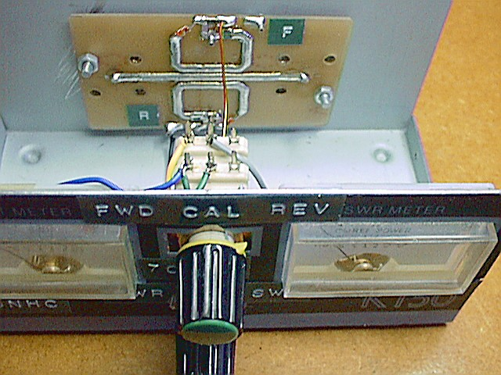
APPLICATIONS
Monitoring / Power measurements
The coupled output from the directional coupler can be used to monitor frequency and power level on the signal without interrupting the main power flow in the system.

Slide 40
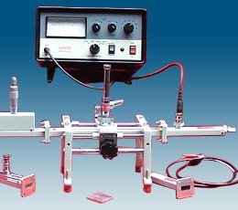
continued……
Frequency measurements
Signal levelling
Reflection coefficient measurements
Signal sampling
Signal injection
Measure incident and reflected power to determine VSWR

Slide 41
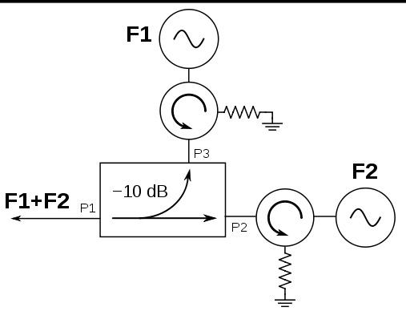
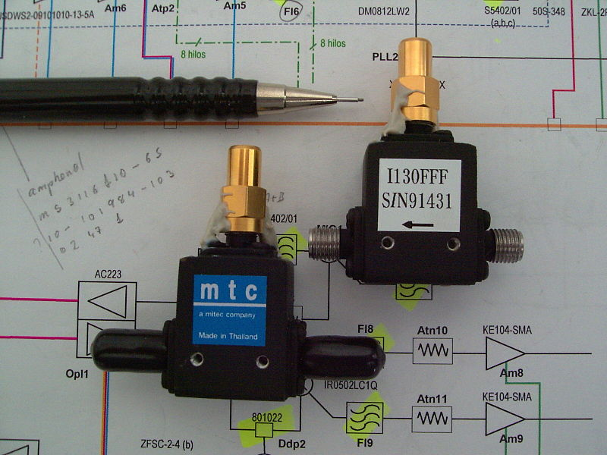
continued……
Making use of isolation-
If isolation is high, directional couplers are good for combining signals to feed a single line to a receiver.

